Slide 1

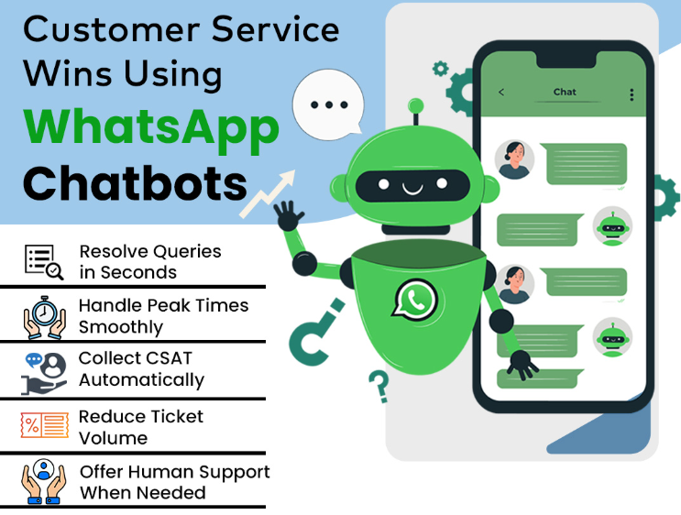
Whatsap Bot
WhatsApp Automation System Customer registration IMPEX – Saudi Arabia
Objective: Reduce service center call traffic
Date : 04-08-2026
Place : Impex, Dubai
Department : Customer service

Slide 2
Proposed Bot Process for home service booking
Customer starts WhatsApp Bot
Customer types:
REG
Bot displays:
Welcome to Impex Service
Please select an option:
1️⃣ Dealer Pick-up Registration 2️⃣ Customer Complaint Registration 3️⃣ Rate Our Service
Please reply with 1, 2 or 3.
CURRENT PROCESS
Customer calls Customer Care
→ CC collects details
→ CC checks product/warranty/invoice
→ Backend registration
→ Service centre allocation
→ Service person contacts customer

Slide 3
2. Customer Complaint Registration
Customer selects:
2️⃣ Customer Complaint Registration
Bot displays the eligible product groups:
Washing Machine
Air Conditioner
Refrigerator
Television
Dishwasher
Chest Freezer
Chillers
Big Coolers
4. Collect Customer Information
The bot collects:
Customer Name
WhatsApp/Primary Mobile Number
Alternate Mobile Number
Complete Address
City
Area/Location
Product Group
Model
Product/Model/Serial Number image
Product image
Date of Purchase
Complaint details
The WhatsApp number should preferably be captured automatically.
3. Product & Model Selection
Customer selects:
Product Group → Model
The system checks the Home Service Eligibility of the selected model.
If eligible
Continue registration.
If not eligible
Bot informs the customer:
This model is currently not eligible for home-service registration.
Please give the complaint product to nearest service center
5. Warranty Status
Customer enters:
DOP – DD/MM/YYYY
The system automatically determines:
IN WARRANTY
or
OUT OF WARRANTY

Slide 4
6. IN-WARRANTY Process
If the product is In Warranty:
Bot:
Your product is identified as In Warranty.
Please upload a clear copy of your purchase invoice for warranty verification.
Customer uploads invoice.
Once all mandatory information is successfully collected:
UID is generated immediately.
The customer receives:
Thank you for registering your service request with us.
Your complaint has been successfully registered.
Service UID: XXXXXXXX
Please keep this UID safely for future reference.
Our service team will verify your request and contact you regarding the service visit.
Thank you for choosing us.
Have a great day!
Then the WhatsApp chat is closed.
7. OUT-OF-WARRANTY Process
If the product is Out of Warranty, the bot displays the applicable inspection charge.
Example:
Your product is currently Out of Warranty.
An inspection/service charge of SAR XXX will be applicable.
Would you like to proceed?
1️⃣ Yes – Proceed with Service
2️⃣ No – I don't want to pay

Slide 5
8. OW – Customer Agrees to Pay
Customer selects:
1️⃣ Yes – Proceed with Service
If payment is required at this stage:
Payment process → Payment confirmation
Once the required confirmation/payment condition is fulfilled:
UID is generated immediately.
Bot sends:
Thank you for confirming the service request.
Your service request has been successfully registered.
Service UID: XXXXXXXX
Please keep this UID safely for future reference.
Our service team will verify your request and contact you regarding the service visit.
Thank you for choosing Impex.
Have a great day!
Chat closes.
9. OW – Customer Initially Does Not Want to Pay
Don't immediately close the customer.
Customer selects:
2️⃣ No – I don't want to pay
The bot should make one controlled conversion attempt.
For example:
We understand your concern.
Since this is an Out-of-Warranty service request, an inspection charge is applicable.
Our technician will inspect the product and advise you regarding the required service/repair.
Would you like to proceed with the service by paying the applicable inspection charge?
1️⃣ Yes – Proceed
2️⃣ No – Cancel Service Request
If the customer changes their decision:
YES → payment/confirmation → UID generated → successful registration message → chat closed.

Slide 6
11. Backend India Staff Process
This is the key sequence after the WhatsApp registration.
WhatsApp Bot
Collects all information
↓
Checks IW / OW
↓
Customer accepts required conditions
↓
UID generated immediately
↓
UID sent to customer
↓
WhatsApp chat closed
↓
Backend India Staff
Receives complete data
↓
Verifies all information
↓
Records/registers case in Service CRM using the same UID
↓
Service CRM registration completed
↓
Service Team
Service person receives the case
↓
Service person calls customer
↓
Service visit / inspection / repair
10. OW – Customer Still Refuses
If the customer again selects:
2️⃣ No – Cancel Service Request
Then:
Thank you for contacting Impex Service.
Your request has been cancelled as you have chosen not to proceed with the applicable Out-of-Warranty inspection charge.
Cancellation Reason: OW – Customer Not Willing to Pay
“You may contact us again if you wish to proceed with the service”.
Thank you and have a great day.
No UID should be generated for a cancelled request.
However, the enquiry should still be recorded in the backend data.
This is important because management can later see how many OW enquiries were lost because customers refused the charge.

Slide 7
13. PROPOSED WHATSAPP PROCESS
Customer sends "REG"
↓
Customer Complaint Registration
↓
Product + Model Selection
↓
Home-Service Eligibility Check
↓
Customer & Product Details
↓
DOP
↓
Automatic IW / OW Identification
↓
IW
Invoice → UID → Customer
OW
Charge → Customer Acceptance/Payment → UID → Customer
↓
WhatsApp Chat Closed
↓
Complete data transferred to India Backend
↓
India Staff verifies & registers in Service CRM using same UID
↓
Service person receives case
↓
Service person calls customer
12. Important Difference Between UID and CRM Registration
I would clearly explain this to management and the developer:
UID generation and CRM registration are two separate activities.
UID
Generated by the WhatsApp registration process immediately after successful customer registration.
CRM Registration
Performed by the India backend staff after receiving and verifying the complete data.
The same UID generated by the WhatsApp system must be carried into the Service CRM.
This prevents the customer from waiting for the backend team to complete CRM entry before receiving a reference number.

Slide 8
OPTION 3 – CUSTOMER FEEDBACK USING UID
3. UID Validation
The bot checks the UID against the service database/backend Excel.
If UID is invalid
The Service UID entered could not be found.
Please check the UID and enter it again.
Allow customer to retry.
After a reasonable number of unsuccessful attempts, the bot should provide Customer Care contact information or close the interaction.
1. Customer selects Option 3
Customer sends:
REG
Bot displays:
Welcome to Impex Service
Please select the required option:
1️⃣ Dealer Pick-up Registration 2️⃣ Customer Complaint Registration 3️⃣ Rate Our Service
Please reply with 1, 2 or 3.
Customer selects:
3️⃣ Rate Our Service
4. Check Whether Feedback Already Submitted
The system checks whether feedback has already been submitted.
If feedback already submitted:
Feedback for this Service UID has already been received.
Thank you for your valuable feedback.
Close chat.
If no feedback:
Continue to questionnaire.
2. Ask for UID
Bot:
Thank you for choosing Impex Service.
To provide feedback about your completed service request, please enter your Service UID.
Example: SA2608040001
Customer enters UID.

Slide 9
Q4. Complaint Resolution
This is one of the most important additions.
4. Was your reported problem resolved?
1️⃣ Completely Resolved 2️⃣ Partially Resolved 3️⃣ Not Resolved
Required: YES
This is better than asking only for a 1–10 score because it directly tells us whether the service actually solved the customer's problem.
If "Partially Resolved" or "Not Resolved"
The bot can ask:
Please briefly explain what issue is still pending.
This comment should be flagged for backend follow-up.
Q5. Response Time
5. How satisfied are you with our response time?
Please rate from 1 to 10 1 = Very Poor | 10 = Excellent
Required: YES
Q6. Overall Service Experience
6. How would you rate your overall experience with Impex Service?
Please rate from 1 to 10 1 = Very Poor | 10 = Excellent
Required: YES
This can become your main Customer Service Satisfaction Score.
Q1. Technician Behaviour
1. How would you rate the technician's behaviour?
Please rate from 1 to 10 1 = Very Poor | 10 = Excellent
Required: YES
Q2. Technician Punctuality
2. How would you rate the technician's punctuality / arrival time?
Please rate from 1 to 10 1 = Very Poor | 10 = Excellent
Required: YES
This is useful because a good technician may still create customer dissatisfaction if the visit is significantly delayed.
Q3. Service Quality
3. How would you rate the quality of service provided?
Please rate from 1 to 10 1 = Very Poor | 10 = Excellent
Required: YES

Slide 10
Q7. Product Satisfaction
7. How satisfied are you with your Impex product?
Please rate from 1 to 10 1 = Very Poor | 10 = Excellent
Required: YES
This is particularly useful for our Product Quality Development activities because it separates service dissatisfaction from product dissatisfaction.
Q8. Comments / Suggestions
8. Do you have any additional comments, suggestions or feedback?
Please type your comments below.
If you have no comments, please reply NO.
Required: NO
Q9. Recommendation
9. How likely are you to recommend Impex products/service to your friends or family?
Please rate from 0 to 10.
8. Important Feedback Logic
The bot should have special handling for poor feedback.
For example:
If Overall Service ≤ 5/10
Bot can ask:
We are sorry that your experience did not meet your expectations.
Please tell us briefly what went wrong so that our team can review and improve the service.
This comment should be flagged for management/backend follow-up.
Similarly:
If Complaint Resolution = Not Resolved
Automatically flag:
"Customer reports issue not resolved – Follow-up required."
This is more valuable than simply storing a low score.

Slide 11
11. Complete Option 3 Process Flow
REG
↓
3️⃣ Rate Our Service
↓
Enter Service UID
↓
UID Validation
UID Invalid
→ Retry UID → After maximum attempts → Support/Close
UID Valid
↓
Check Previous Feedback
Already Submitted
→ Inform customer → Close
Not Submitted
↓
Questionnaire
↓
Save all feedback against UID
↓
Check low score / unresolved complaint
↓
Flag for backend follow-up if required
↓
Thank-you message
↓
Close WhatsApp chat
10. Feedback Final Message
After all questions are completed:
Thank you for your valuable feedback!
Your feedback has been successfully recorded against Service UID: XXXXXXXX.
Your feedback helps us improve our products and service quality.
Thank you for choosing Impex.
Have a great day!
Chat closes automatically.

Slide 12
THANK YOU

